Slide 1
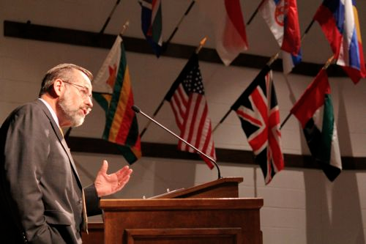
Diekepuzho:
Ketholeshii phriipedikecii
Diekepuzho 1 nu pethavoketuoko
Dr. Rick Griffith • Singapore Bible College • BibleStudyDownloads.org
Dr Alan Stanley, Mueller School of Ministries, Australia

Slide 2
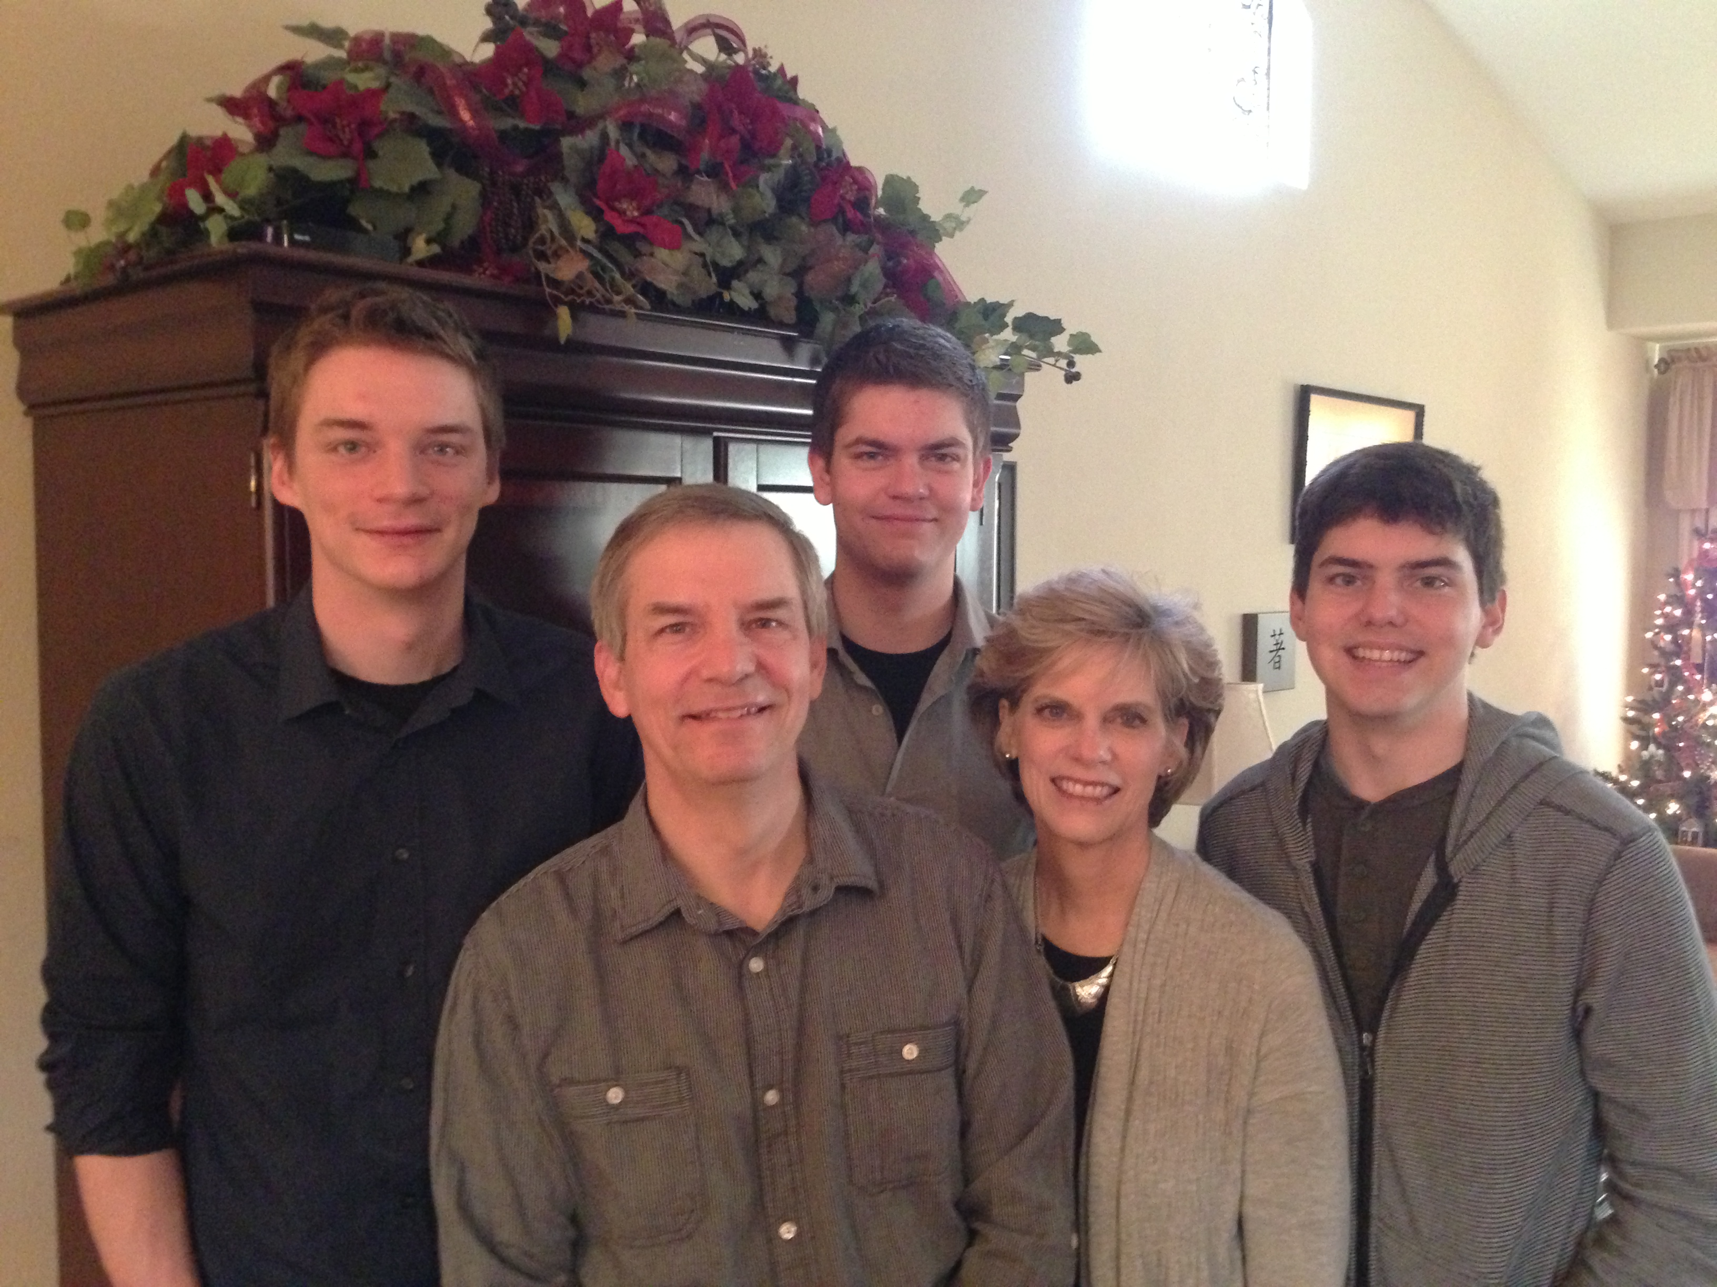
Griffith kikru
Riide 2012
Kurt
26
Stephen
23
John
20
6
Rick
Susan
Notes:
SUSAN: God continues working in our family as we see Him work in our three sons. Our two older ones work in Seattle and our youngest (John) is in his first year at Biola University in Southern CA. We lived in the USA his first semester, pretending that he needed us until we returned to Singapore on January 5.

Slide 3
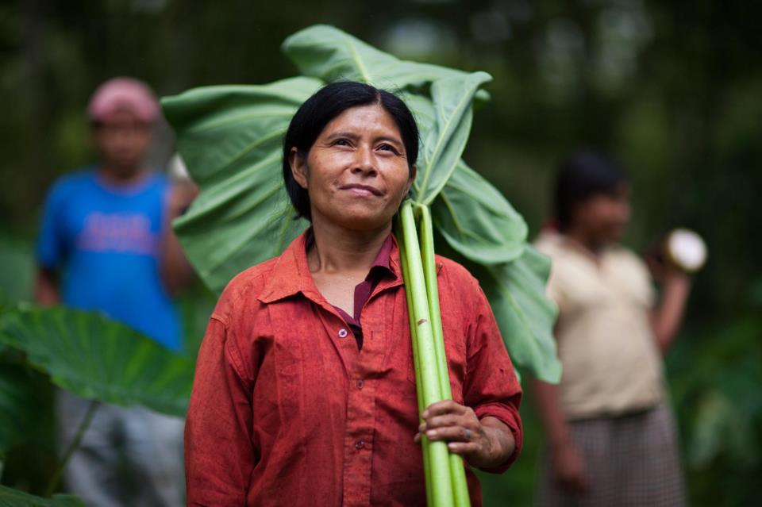


Kurt liro thelhikechii mu IT nu meriya
6

Slide 4
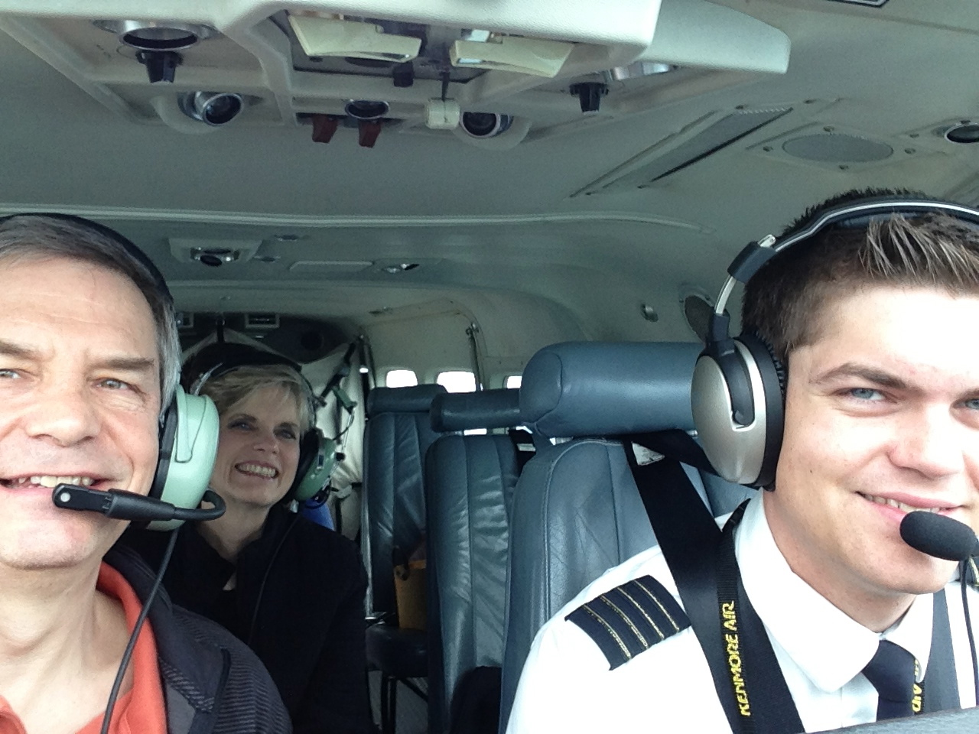
Stephen liro keprokese nu meriya

Slide 5
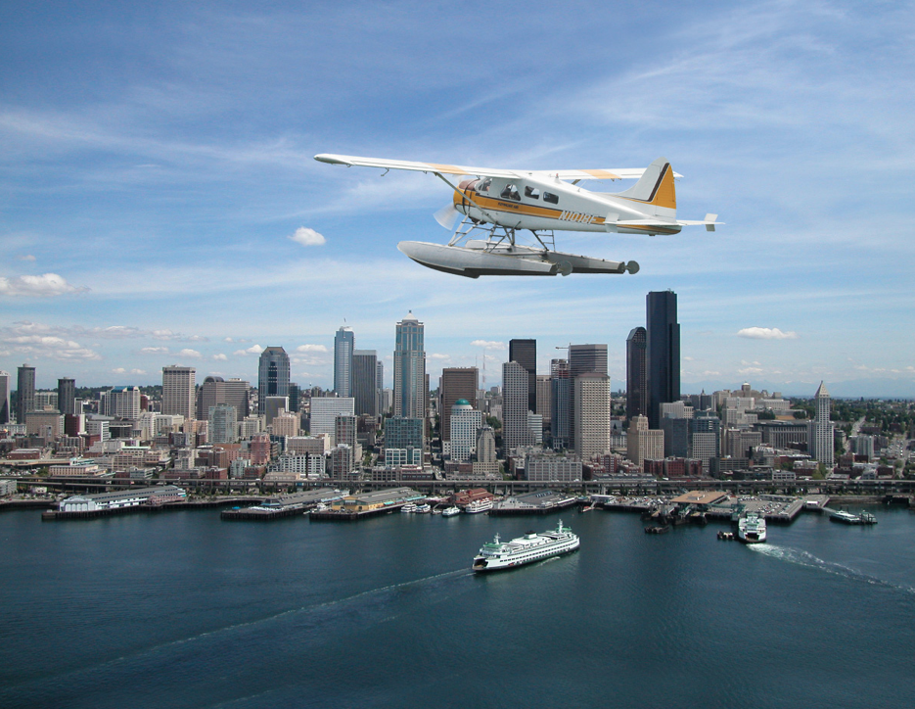
Stephen the Pilot

Slide 6
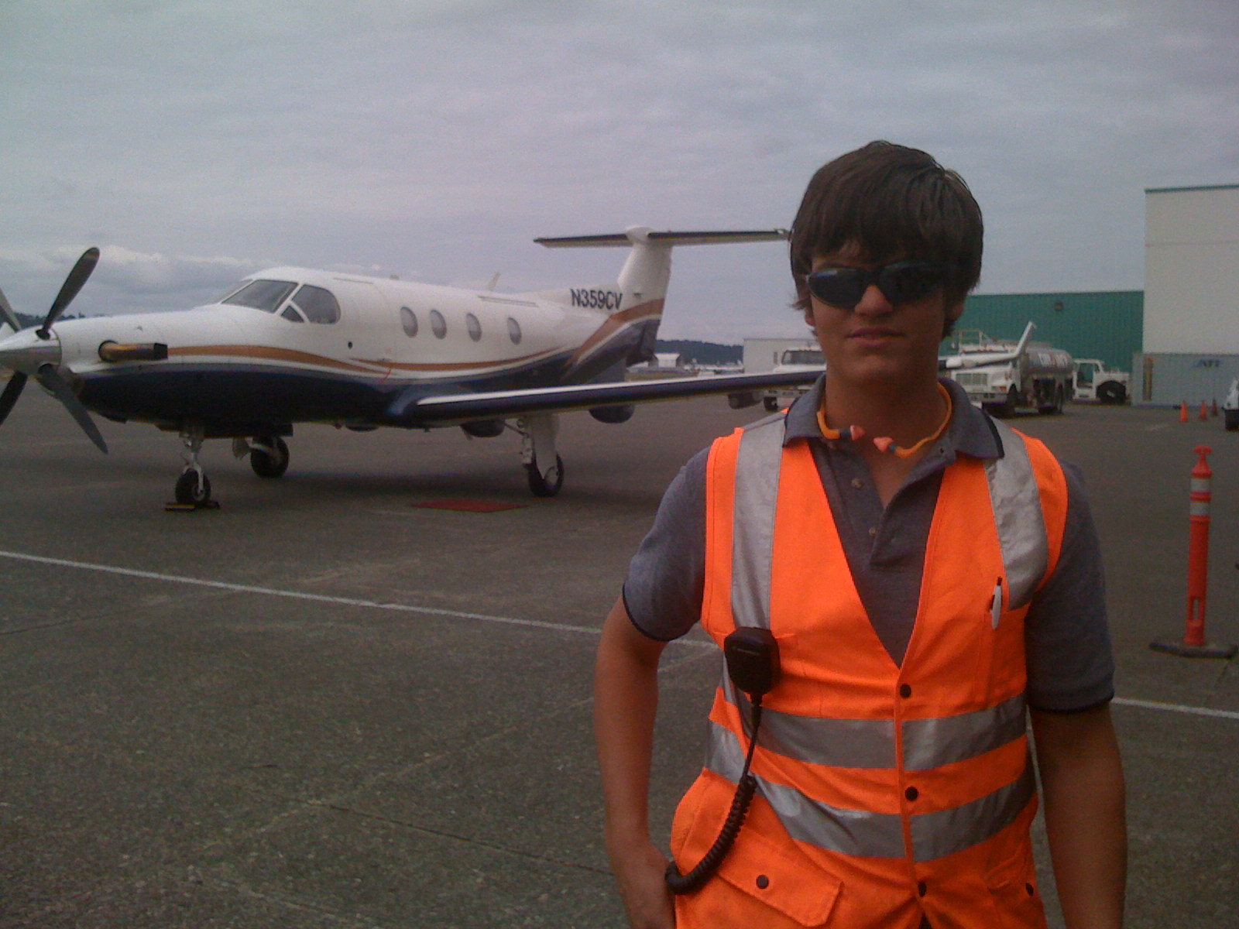
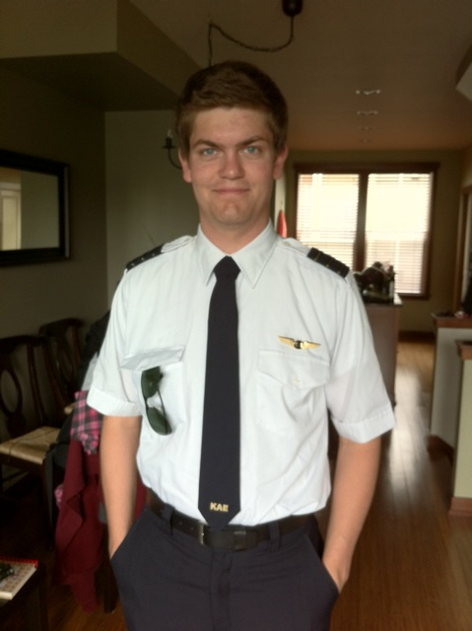
Stephen liro Kenmore Airlines nu captain chiibaya, mu hau liro Boeing Field, Seattle nu ba.
6

Slide 7
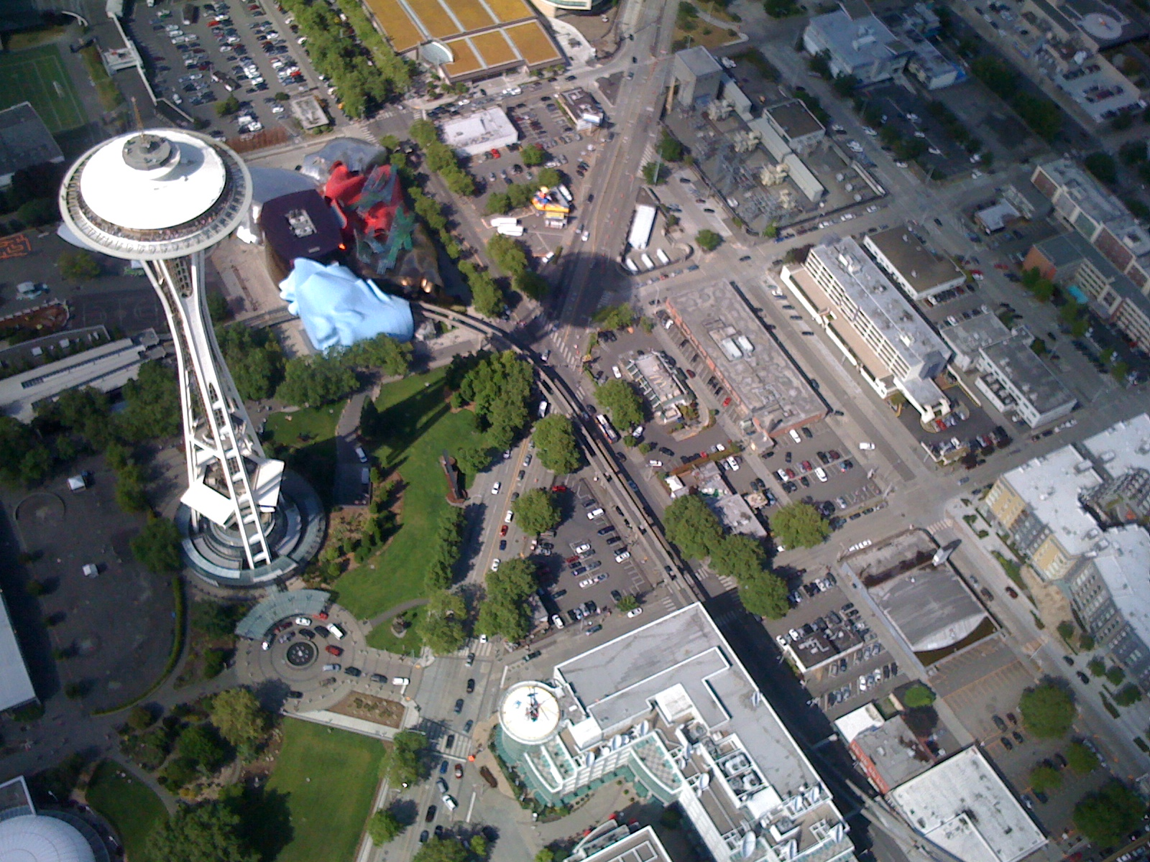
Keriikrie nu Seattle mehokeshii
6

Slide 8
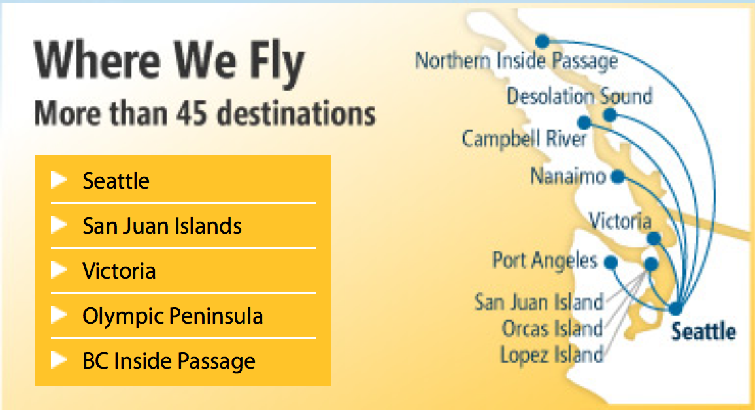
Stephen liro Kenmore Airlines ze pruo San Juan Islands nu vo ya
Hieko pruokecii
Thechii hediepengou kezie
6

Slide 9
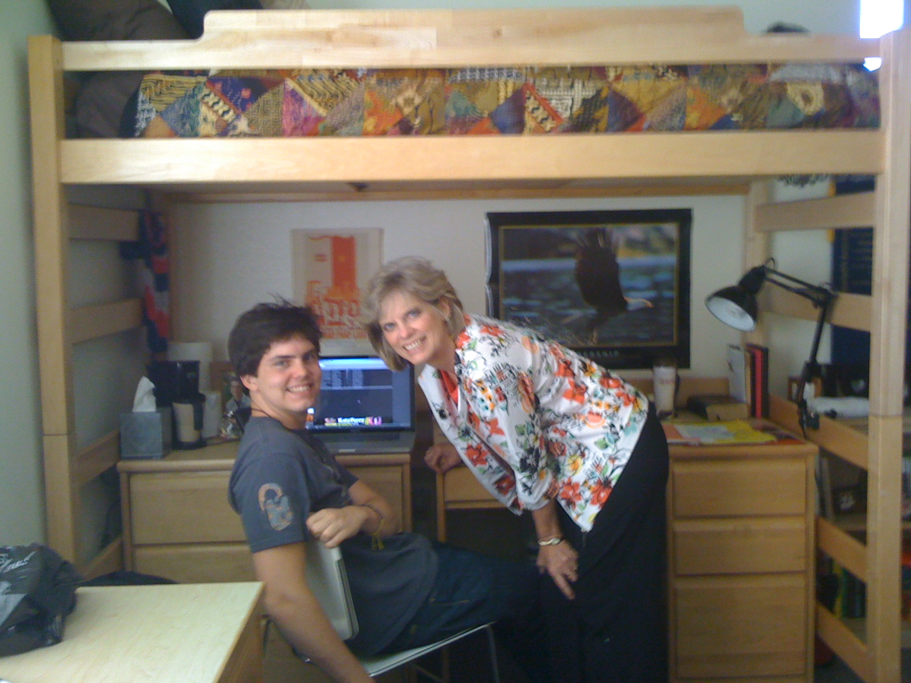
John liro Biola University nu phriibaya

Slide 10
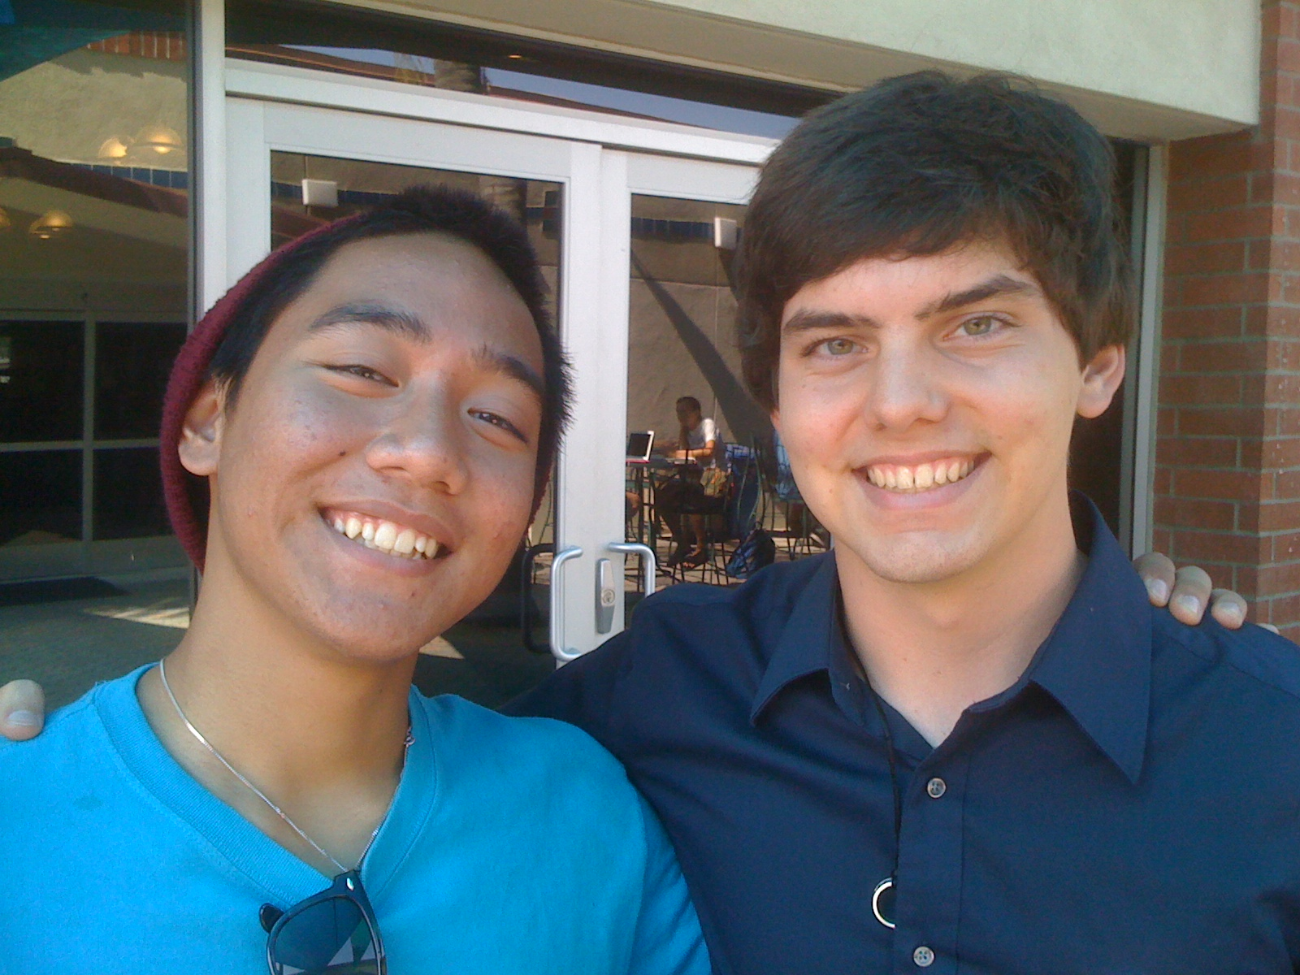
John at Biola University

Slide 11

Hieko Mission Organization liro…

Slide 12
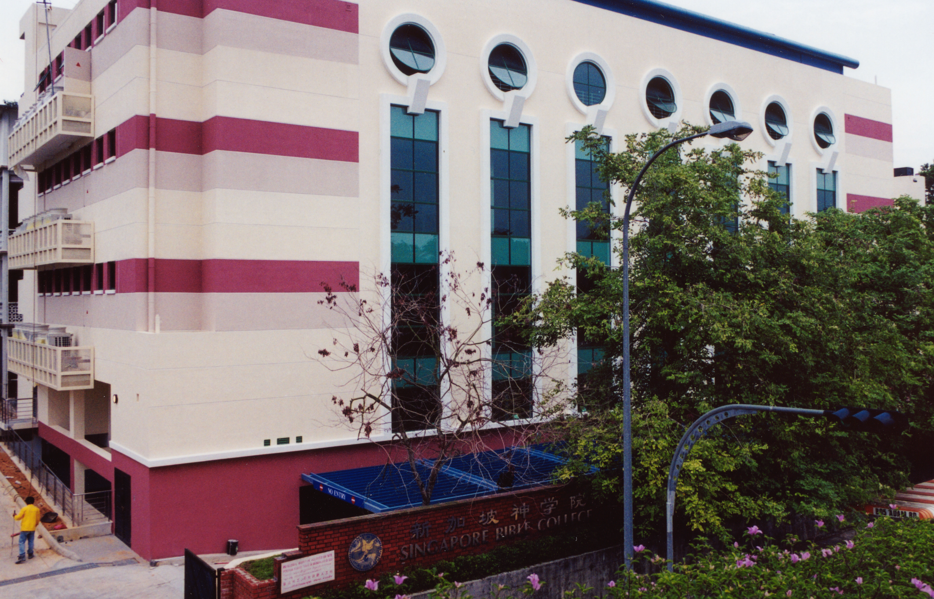
SINGAPORE BIBLE COLLEGE
Notes:
I’ve served as a seminary professor with 30 other faculty at Singapore’s largest training school: Singapore Bible College

Slide 13
SBC nu akepetha mhatho
(Kekradie • Bahasa • Chinese)
Mehokeshii
OT NT
Siedze kephrii
WOT WNT
Ukepenuopfii dze
Kehouki Kemesa ropfii vorketuodze
Diekepu
Diekepuzho 1 Diekepuzho 2
Notes:
I get to teach these leaders every book of the Bible in survey courses, plus backgrounds to both the OT and NT, three areas of theology, and how to preach.

Slide 14
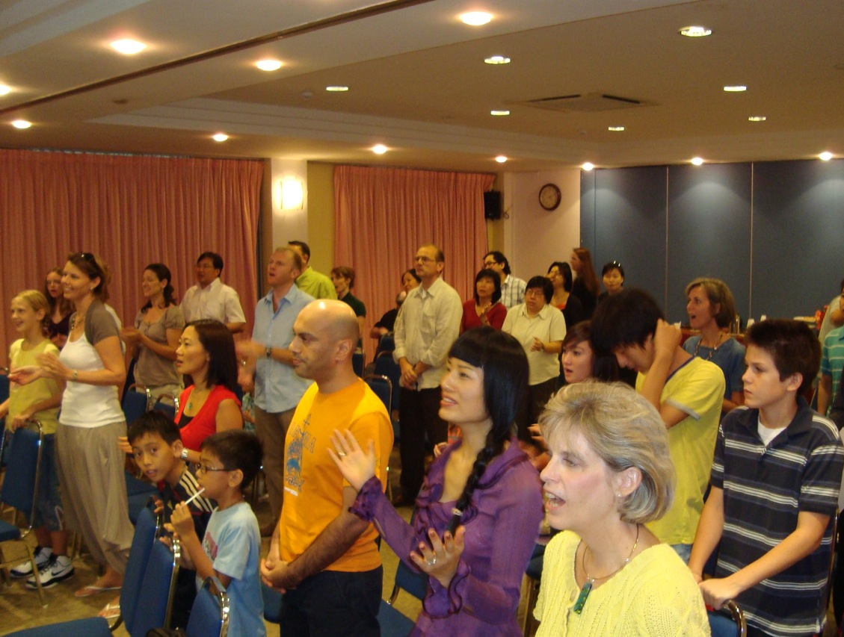

Our People
Thechii thetha nunu mia serthenie vor kehouya

Slide 15
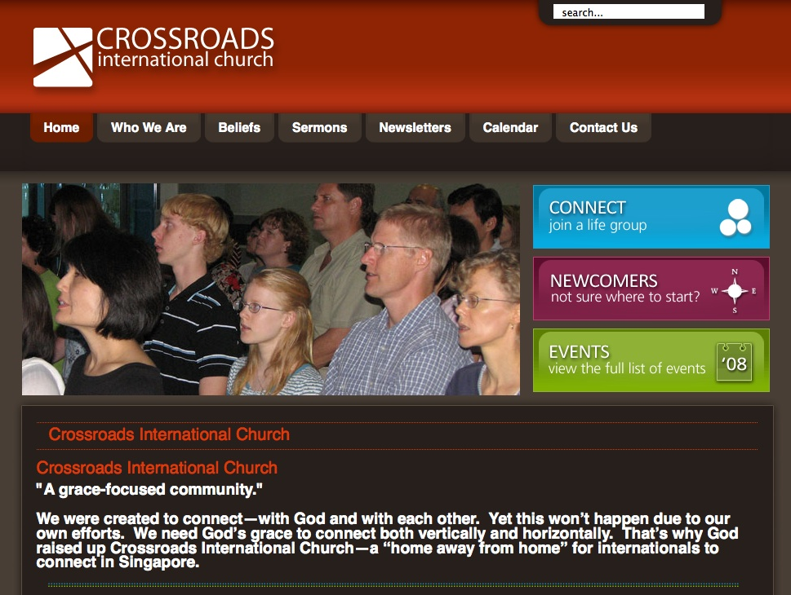

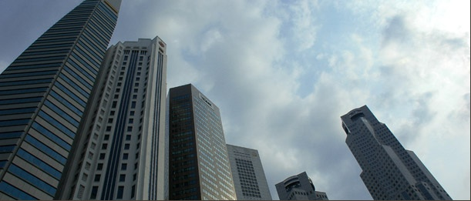
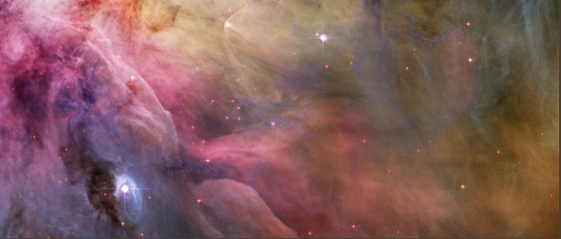
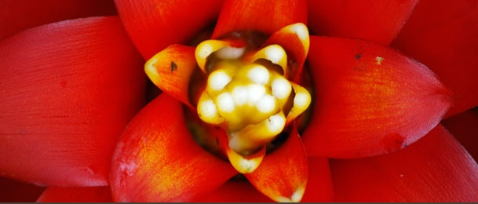

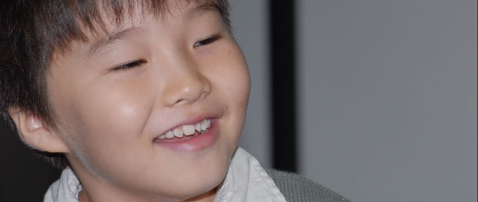
www.cicfamily.com

Slide 16
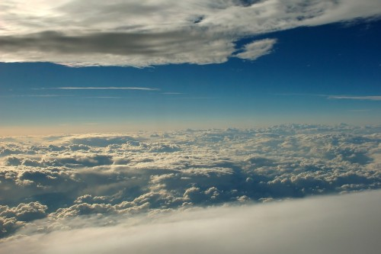
Ukepenuopfii die kekuo (Isa. 55:8-9)
“A nouleko sii nie nouleko mo,
siro nie zhoko rei a zhoko mo,” Jihovaa siya.
⁹ “Teiko-a kijiiu ki keriikrie tuoi, a zhoko rei nie zhoko ki riikrie, mu a nouleko rei nie nouleko ki riikrie.”

Slide 17

Ukepenuopfii die kekuo (Isa. 55:10a)
“Teirii mu pekrie teigei nu tsurya, mu siinu la kho mo di kijii tsheshii.”

Slide 18
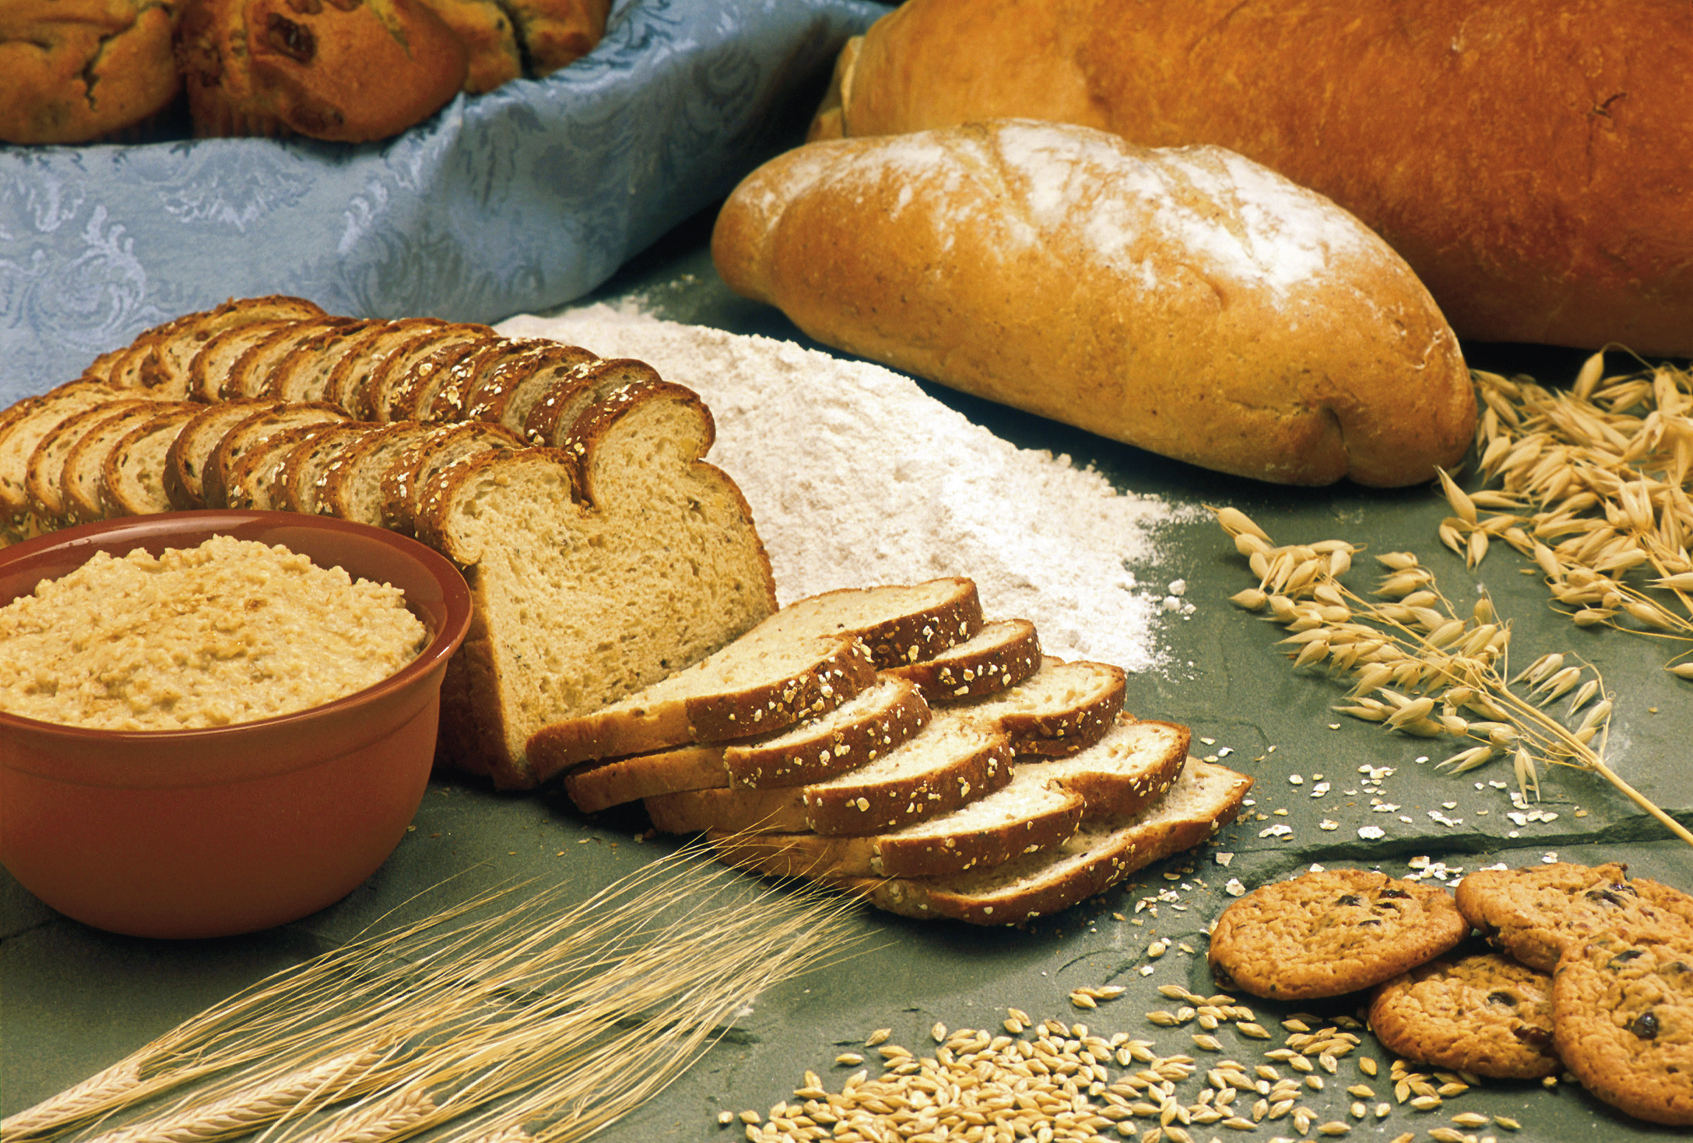
Ukepenuopfii die kekuo (Isa. 55:10b)
“Di puo bu mha pethe pelhoushii di tsia viipie tsiavau tsii, mu chavapie kechiiu tsiiyakechii tuoi.”

Slide 19
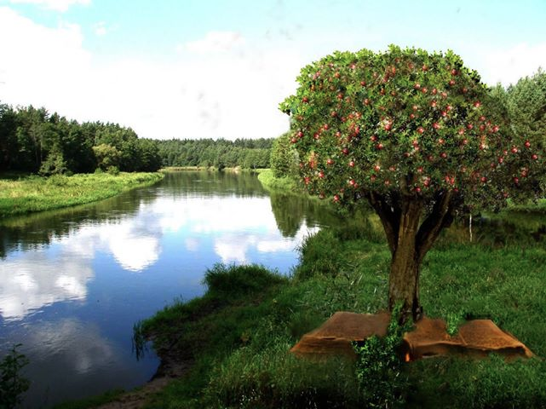
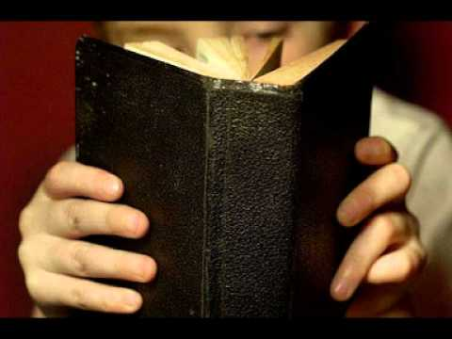
Ukepenuopfii die kekuo (Isa. 55:11)
“A tie nunu kepra a dieu rei situo;
methuo zo di a ki la vor lielho,
derei a rakeshiiu,
mu a puo bu chiinu di puo ketsekeshiiu nu vi kehielietuo.”

Slide 20

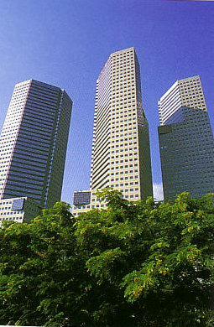
Our Course Goal
Uko mharhii: hanie piephi kemakecii!

Slide 21

Pethavoketuoko
v
Kikemhiedi u diekepuko puo sie puo di chiivotuoshikecii, sedeu nu
  Ketholeshii dieko vatsa pedikeshii,
  Diekepuzho rhi-u sikelie,
  Die kemeyieko pieparkecii,
  Kele kekreikropuo se di ke kekhrohikecii (ubu kedipuo chiimorosuo ga?, thedze se vatsa pedikecii, tsieteiu nu ula kedipuo pu ga ga?, Sedeu, theladieko),
  Kethu nu, mu
  Va kenie class nu diepu tuo mu diekepu kekrei kenie sa.
Teitsei kepra mu kemeyie teisozhako nu diekepu (thedze, kepu morosuo kropuo, mialei-u diepu, kelakeliedze, kerikecii, mu kesia diepu) liro Diekepuzho kenieu nu ngulietuo.

Slide 22


Pethavoketuoko
v
Pethakewasie hako siliekecii mese te…
A. Kedipuo mu ki-iidi hako ca putoukeshii
Puoca vatsakeshii mu diekepuzho rhi-u
Sedeu, puomo-u, mu thelau pu kemeciikeshii
U mhoshii di diepu kelie
Menuo di thedze kevi kedapie pu meciisakuokelie
F. Ketholeshii kepetha die tsieteiu nu ula kedipuo pu bashikecii
G. Diepu pevisakuolieketuola meho pedilakeshii
H. Kepetha (“kedipuo”) epistol mu thedze
I. Kepetha (“kikemhiedi”) ketho, unoukemvii, mecii, mu ula meviketuo die (puoca kemeyieko puolha 25 nu ba).

Slide 23
Mha kemeyie die:
Udiepu bu…
25
Ketho
Unoukemvii
Mecii
Ula meviketuo

Slide 24



Leshiida semorosuo kropuo
v
kephrii (10%)

Slide 25

Leshiida phrii kerietho-u
Puolha mepfii leshiida hayo phriilie di vorlie

Slide 26
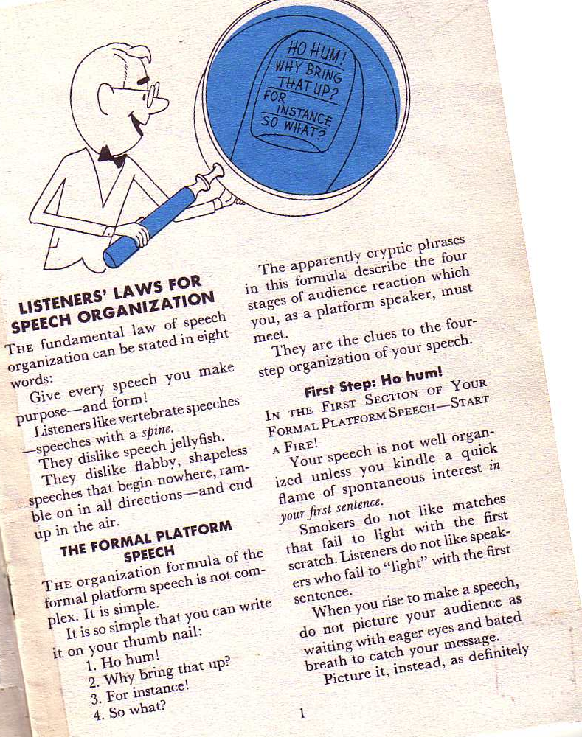
Borden kepetha kemeyie kropuo
10-11
Diepukecii ki mha kemeyitho kenie liro:
N diepu pete nu puoca mu puorhi nyi lie cie!
Richard Borden, kikemhiedi u kele kezalietuoga, 1

Slide 27
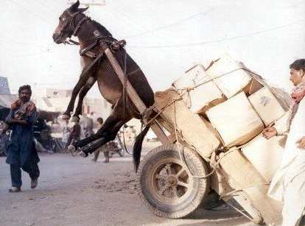
SBC Pethavoketuoko
v
Kephrii (10%)
Mhatho (15%)

Slide 28



Diepuzho se mia pethakhe !
“Siro no themia kekra kesi kengu nunu a kinu die riinyiikelieko, no siiko khapie mia kekreimia rei petha liekevimia, mia bu rei u pele liekevimia dzie nu shiishiiliechie." (2 Tim. 2:2).
Siedzikeshii
Paul
Timothi
Pelelie-kesiimia
kekreimia

Slide 29
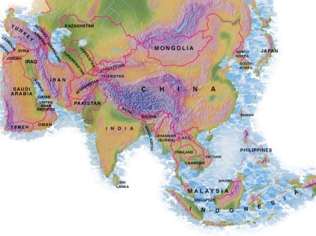
Kepetha lietho 1997-2013
Kemerie = Thechii hako nu a diekepuzho pethakewa
MONGOLIA
JORDAN
KOREA
CHINA
NEPAL
MYANMAR
INDIA
THAILAND
VIETNAM
MALAYSIA
SRI LANKA
SINGAPORE
INDONESIA
Notes:
From 1997-July 2013 God has seen fit to grant me the privilege to train pastors in 12 other countries on 50 trips. I have taught Homiletics in 8 of these.

Slide 30

biblestudydownloads.com

Slide 31
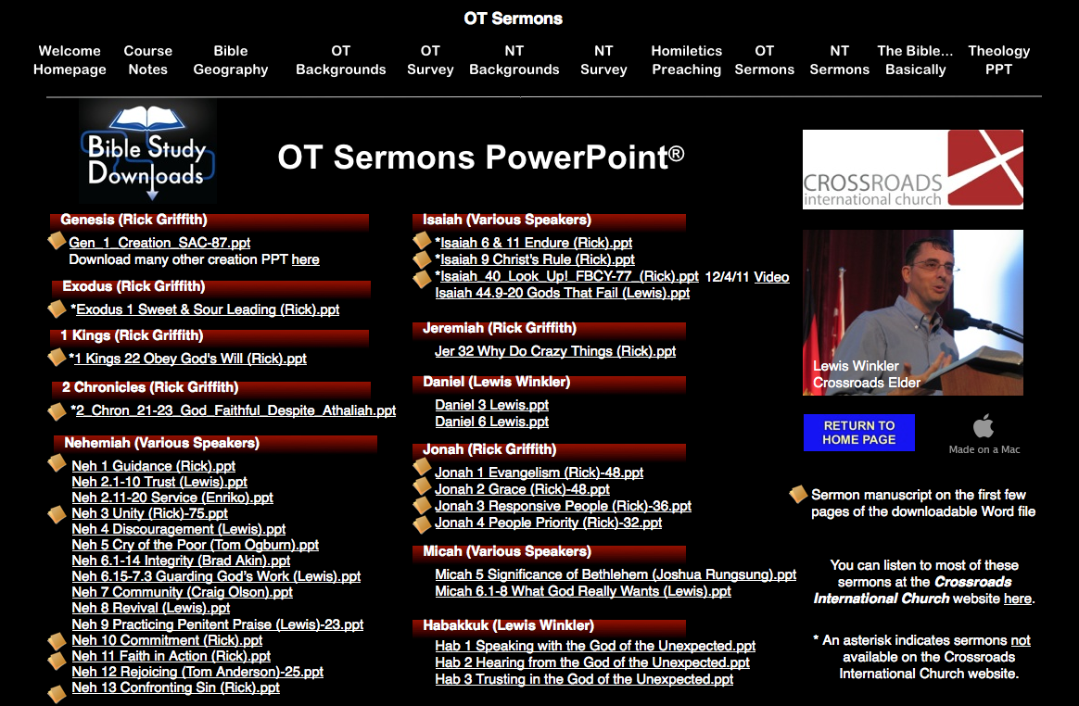
OT Sermons PPT
biblestudydownloads.com

Slide 32
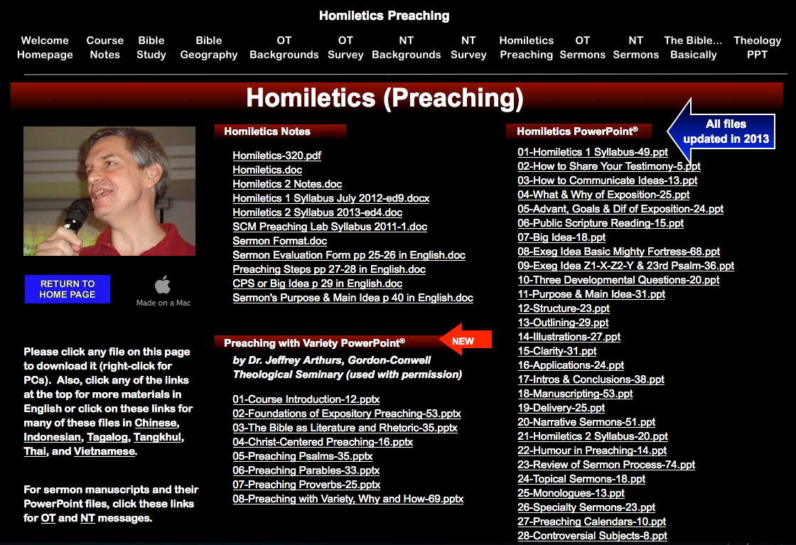
Homiletics PPT
biblestudydownloads.com

Slide 33
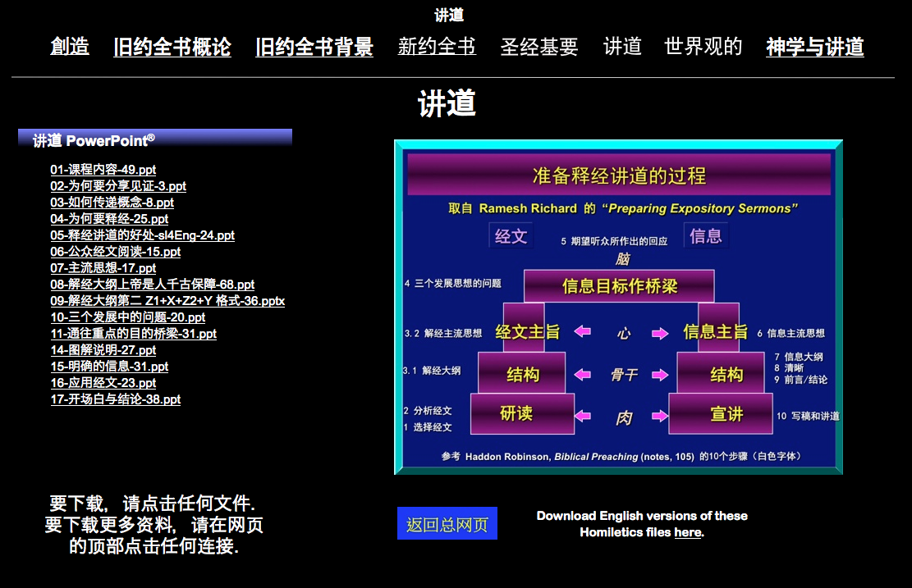
Chinese Homiletics PPT
biblestudydownloads.com

Slide 34
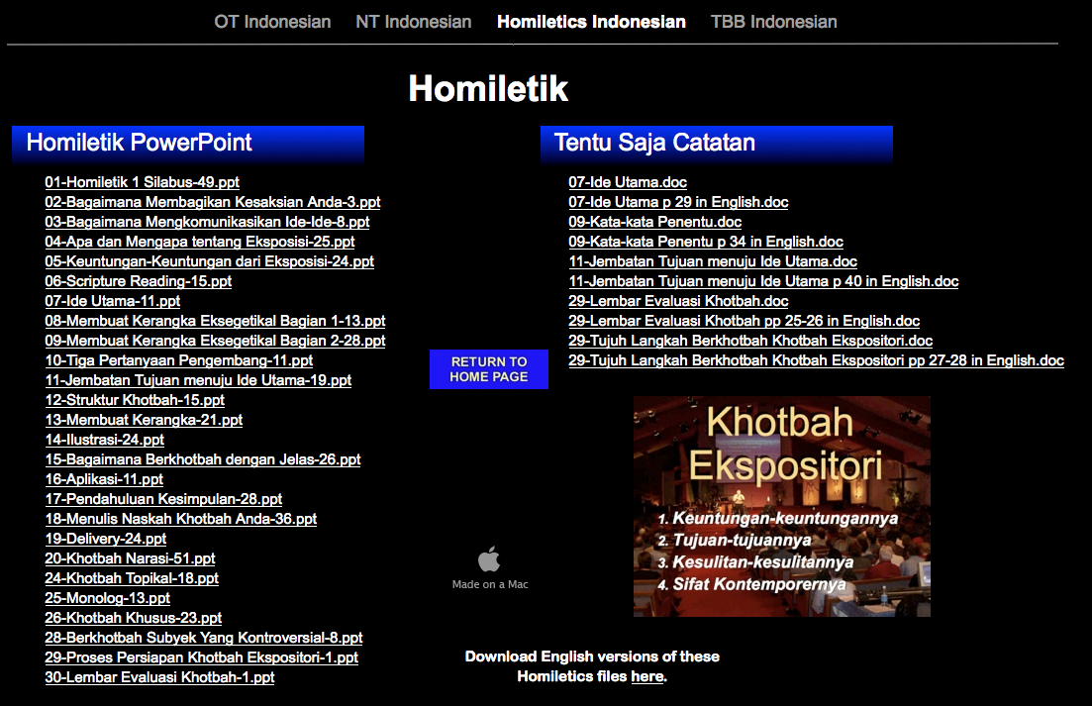
Indonesian Homiletics PPT
biblestudydownloads.com

Slide 35
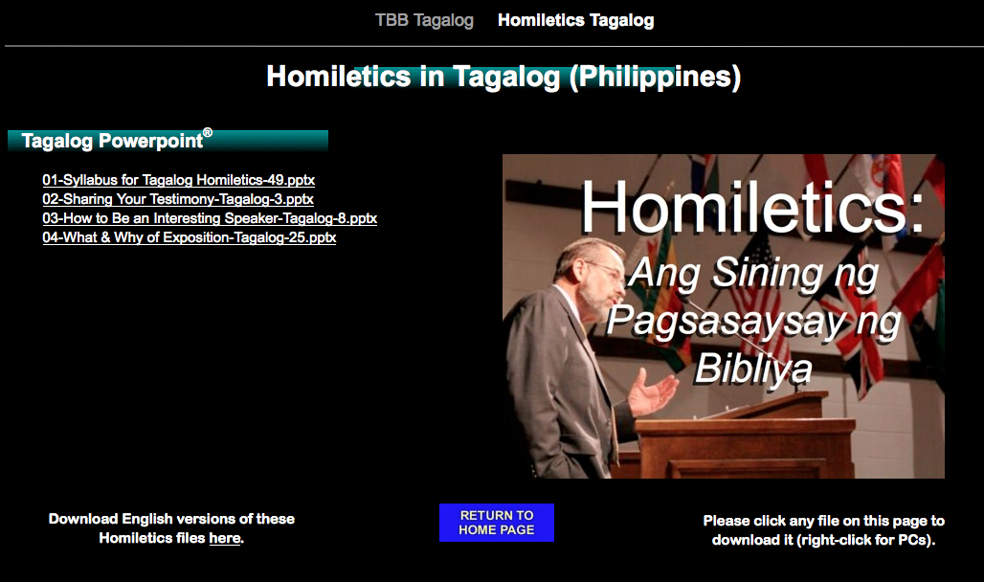
Tagalog Homiletics PPT
biblestudydownloads.com

Slide 36
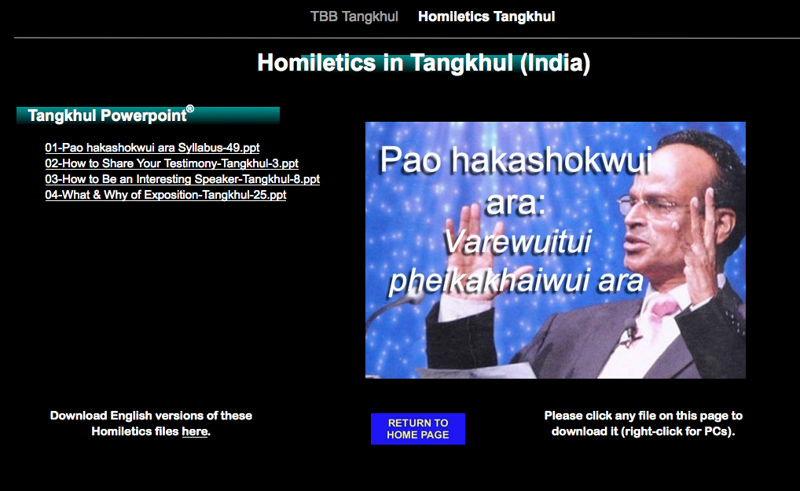
Tangkhul Homiletics PPT
biblestudydownloads.com

Slide 37
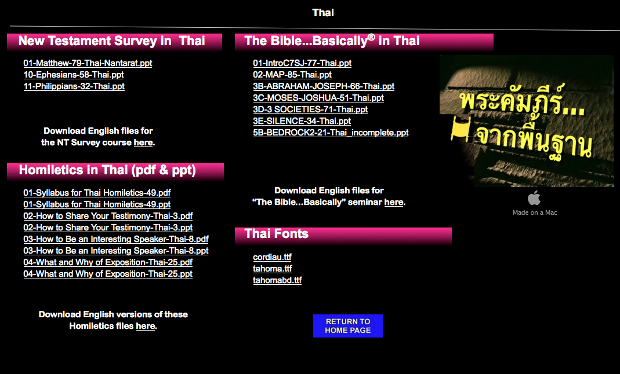
Thai Homiletics PPT
biblestudydownloads.com

Slide 38
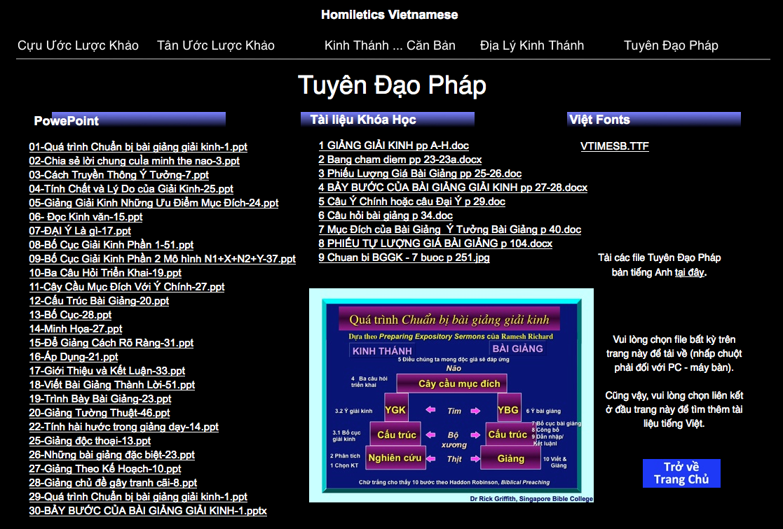
Vietnamese Homiletics PPT
biblestudydownloads.com

Slide 39
SBC Pethavoketuoko
vi
Kephrii (10%)
Mhatho (15%)
Kethukropuo (25%)

Slide 40

Kethu mhatho kerekenieko
vii
Kethuko-a u diepuvoketuoko nu u khruohilieya

Slide 41
Ki-iidi u zhapu khashii morosuo ga ?
16
U thuo u dze sii pu riiphi
No kesi tho-u zo
Zhapu chiiliekevi puotei kevipuo
Dr Rick Griffith, Singapore Bible College
www.biblestudydownloads.com

Slide 42
Zhapu chiikecii zho medzi vo morokesuo kropuo
16
Riidikeliesie:
N kele
N kelhou nu riidikecii
Pu kemeciikeshii!
Riidikelieki:
Riidikelie dze
N kepele
Pu kemeciikeshii!
Krista sikemoki:
N kele
N zho
Pu kemeciikeshii!
Kele kemhietoukeciiukhabakelie!

Slide 43
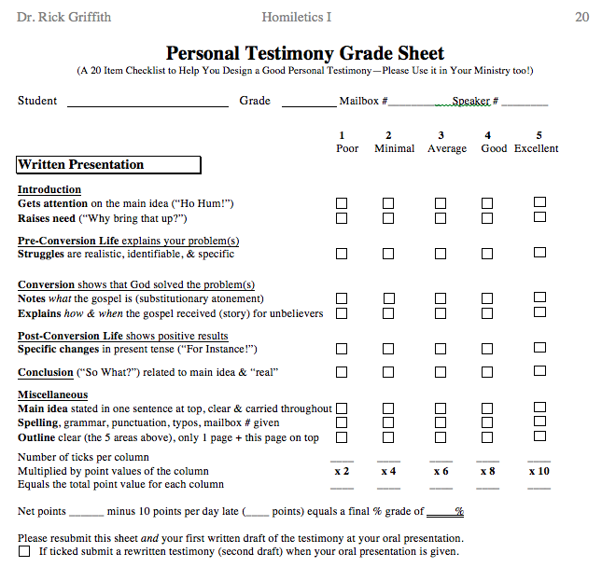
Testimony Grade Sheet
20
Sedeu
Khrista sikemoki
Riidikelie dze
Riidikeliesie
Thelau
Mhakekri
morokesuo kropuo

Slide 44
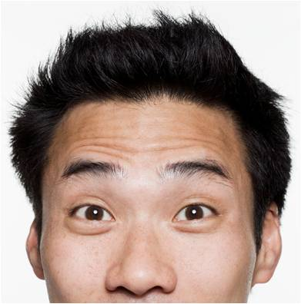
U mhathoko suopuo tsiita?
Dr Rick
Dr Clive

Slide 45
SBC nu Pethavoketuoko
vii
Kephrii (10%)
Mhatho (15%)
Kethu mhatho (25%)
Diekepu (50%)

Slide 46


Diekepuzho rhiu
vii
Sedeu (1 min.)
Zhapudie (2-3 min.)
Miahiikecii diepu (2 min.)
Leshiikethu zhapu (15 min.)
Thedze zhapu (15 min.)

Slide 47
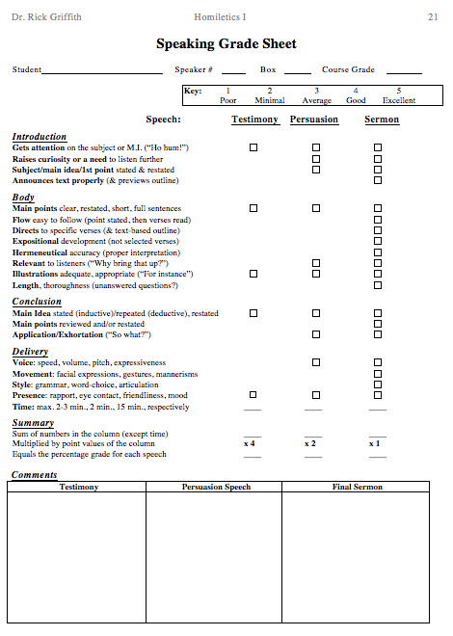
Diekepu zhakhra leshii
21
“Sedeu!"
Kemeyieko
“Pu kemeciikeshii!"
Puobo-u
N kesezho

Slide 48
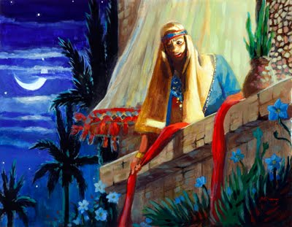
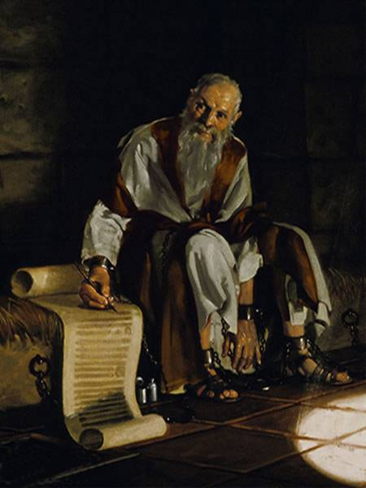
N diekepu kenienie
vi
Kethu zhapu
Riiko
Khuso puonu vo kenie mese
Joshua
Rekuo
Thuthe puo

Slide 49
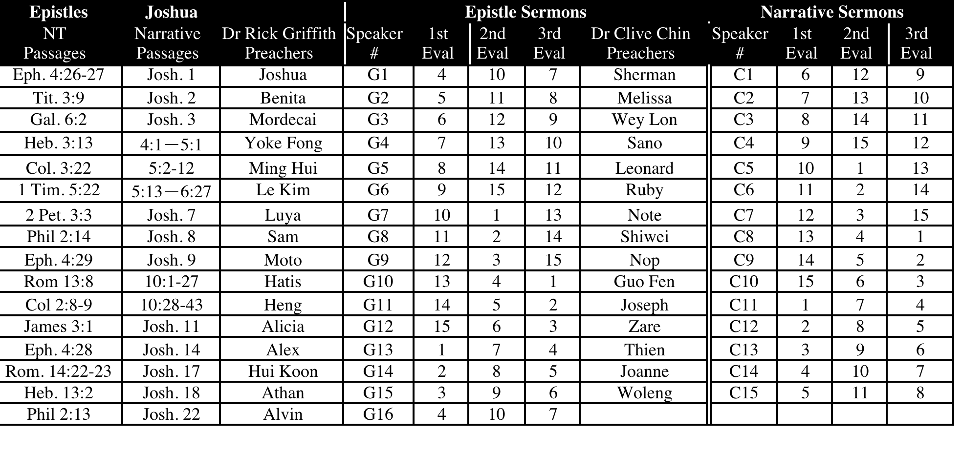
SBC Diekepuko mu Capiko 2013
vi
July-Nov 13

Slide 50
Kethu zhapu Khusoko (15 min.)
B
Rom 13:8
Huoniehuo khriekechii tsatie sie mia puo pu rei pfii hie: puo siezanuomia khrieyakezhamia thezho-u chii tseilieya.
Rom 14:22-23
²²No mha puo si tou ro, siiu pie n thuo n kitsa mu Ukepenuopfii mhinguki ba zolie. Themia kehoupuorei mha kehoupuorei si tou di puo thuo puo le pejoyakemo-u ruokuothomia zo ²³Derei kehoupuorei kenounie di chii ro, siiu jotaya; kekreilamonyii puo pele mo di chiikechii la; mu mha kehoupuorei kepele nunu kemo kheko kephouma zo.
Gal 6:2
²Nieko kekhoyalie sidi Khrista zho-u chii tseiliecie.

Slide 51
Kethu zhapu Khusoko (15 min.)
B
Eph 2:10
¹⁰Sizomonyii we ha puo mhatho kro puo zo, mha kevi chiinu di Khrista Jisu nunu u chii kesakelie zo; Ukepenuopfii u bu mha siiko chii tuonukechii la pedzii perie kesese tuote.
Eph 4:26-27
²⁶Nie nei mo rei kejo kemou we chiita hie: nie noumeyie ba teiniaki pele hie: ²⁷siro u ngumviido-u ba perie reishii hie.
Eph 4:28
²⁸Thiedzii riigukezhamia buriigu la hie; sizomonyii puo mha pie ketsopfiimia tsiiii zalieketuo la puo bu puo rhie chii di puo thuo puo dzie pie mha kevi rei chii salie.
Eph 4:29
²⁹Keriitse keriira die puorei bu nie tie nunu par hie, derei nieko die keriinyiiko bu vilieketuo la pu kezhii ki die kevi riipie pulie.

Slide 52
Kethu zhapu Khusoko (15 min.)
B
Eph 6:4
⁴Siro mia kriinuoko nieko rei nie nuonuo nou vakeriida hie; sikechiiumonyii Niepuu puo neikechii thatha mu tahitarhokechii se uko pethaliechie.
Phil 2:13
¹³Kekreilamonyii puo nei puo medoko chii zolietuoii di nie nu chiipie nie bu chii nyiilie mu chiilieyakezha siiusii Ukepenuopfii zokechii la.
Phil 2:14
¹⁴Panya para mu mia ze kemeii hie di mha kehoupuorei chiiliechie.
Col 2:8-9
⁸Miapuorei bu themia mhasi mu themia do iise nieko kebvii seketa chii molieketuo la nie kirei terlie; mha siikosii themia zho zo, mu siikosii Khrista zho monyii kijii hanu nhichunuomia kepetha zho therieko zo. Kekreilamonyii Khrista geinu Ukepenuopfii kinyiko pete themia rhi se di lhoukelie la.

Slide 53
Kethu zhapu Khusoko (15 min.)
B
1 Tim 2:11-12
¹¹Thenumia bu mha kehoupuonurei mia khriikhro ba di mene di mia u kepetha die siliechie. ¹²Sizomonyii a thenumia bu sie mia petha morei thepfumia mhokezha chiikechiiu monyii mene di ba mia pfe riinyiikechii chii nyii.
1 Tim 5:22
²²Pemo zo di mia tsii gei n dzie khashii hiechie; mu mia kekreimia kejo rei bu n doukechii chii hie zochie; mu mesa ba zoliechie.
Titus 3:9
⁹Derei mha ketso zhiikemo ketsokechiiko mu u seyie za kephrii mu kedierhekemoko mu thezho-u dze pu kepriilikechiiko therie zolie; kekreilamonyii die siiko mhapuorei kepra jii mu kemethuo-kemeruo zokechii la.
Heb 3:13
¹³Derei kephoumamia sekezhau bu nieko huomia nou chii perekewa keprei la “thie” iikechii keba chie teisonhie nieko huoniehuo tarho ba zoliechie.

Slide 54
Kethu zhapu Khusoko (15 min.)
B
Heb 13:2
²Siiu lanu rei thiedzii huomia teigeidieliemia rei peso rhiilie zo.
1 Peter 2:2
²Siro nieko zha miemie vo kelakelie tsolieketuo la nuoranuoko penuo ze kebako tuoi kerhu kejii ruopfii nudziiu mengu siei zolie.
1 Peter 3:7
⁷Mia nupfunuoko, nieko rei siisii tuoi nie nou mha le di nie nupfiinuo ze lhouliechie. Nie kecha ki mha puo bu rei nie chakha chii molieketuo la nie nupfiinuo iise nie ki kekuo ketsa themia iilie derei nie keze kerheiprii ngukelie mhaphruo kerhe zoiikechii leliechie.
2 Peter 3:3
³Thela tsatie mha krenyii zokechii kro puo mia krenyii zo vortuo; siro uko riiyo u nei u nyii chii di sie,

Slide 55
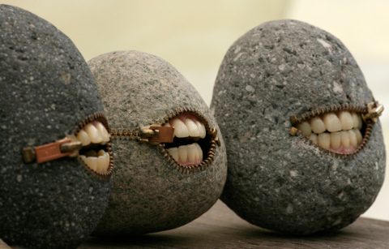
Zhapu chiimo liro ketsiako thuo zhapu chiipartatuo!
Luk 19:40 Sitse Jisu lasie uko iise, “ A nieko ki pushiituo, themia hakoha bu kemekrie zeita rei, ketsieko thuo rei melie u rhie chii siertatuo, sita!”

Slide 56
Diekepu minit kerepengou la hako kese sevorlie…
vii
Diekepu modzii duii…
Puoca kemeyieko n kethu mhatho 7 mu 8 (moro 11 mu 12)
PPT slide(s) vie diepu kemeyieko
Mia pete lanu n diekepu leshii zacie
Kethu leshii khapie ba ro pu kemeciilieya
Diekepu teisozha nhie…
Die kemeyiekro puo separ di n diepu riikraliekevi chiilie
Diepuwakezha zha kenie sie…
Uthuo u dieku meholakevo (p. 104)

Slide 57
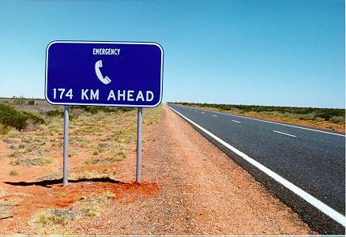
N mhatho n la re ro…
Kekhrohi pfhiilie!

Slide 58
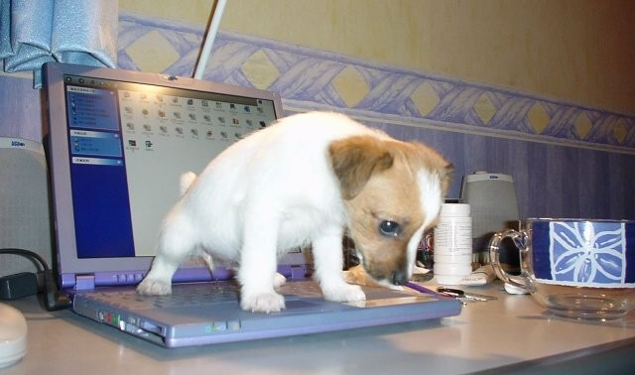
N mhatho pete computer nunu thulie
N computer vie warenti sa khriilie !

Slide 59
Mhakekri kropuo
xi
Klas nu leshiikethu
Apfhiilievi
SBC bou L19 moro diepubu (6559-1513)
Diepubu nomber 9113-7090
A ki liro SBC Block 2-302 nu ba
A ki diepubu nomber liro 6762-2011
E-mail: griffith@sbc.edu.sg
A meri teiu liro…
Keze di mhaciituokhe!

Slide 60
Black

Slide 61
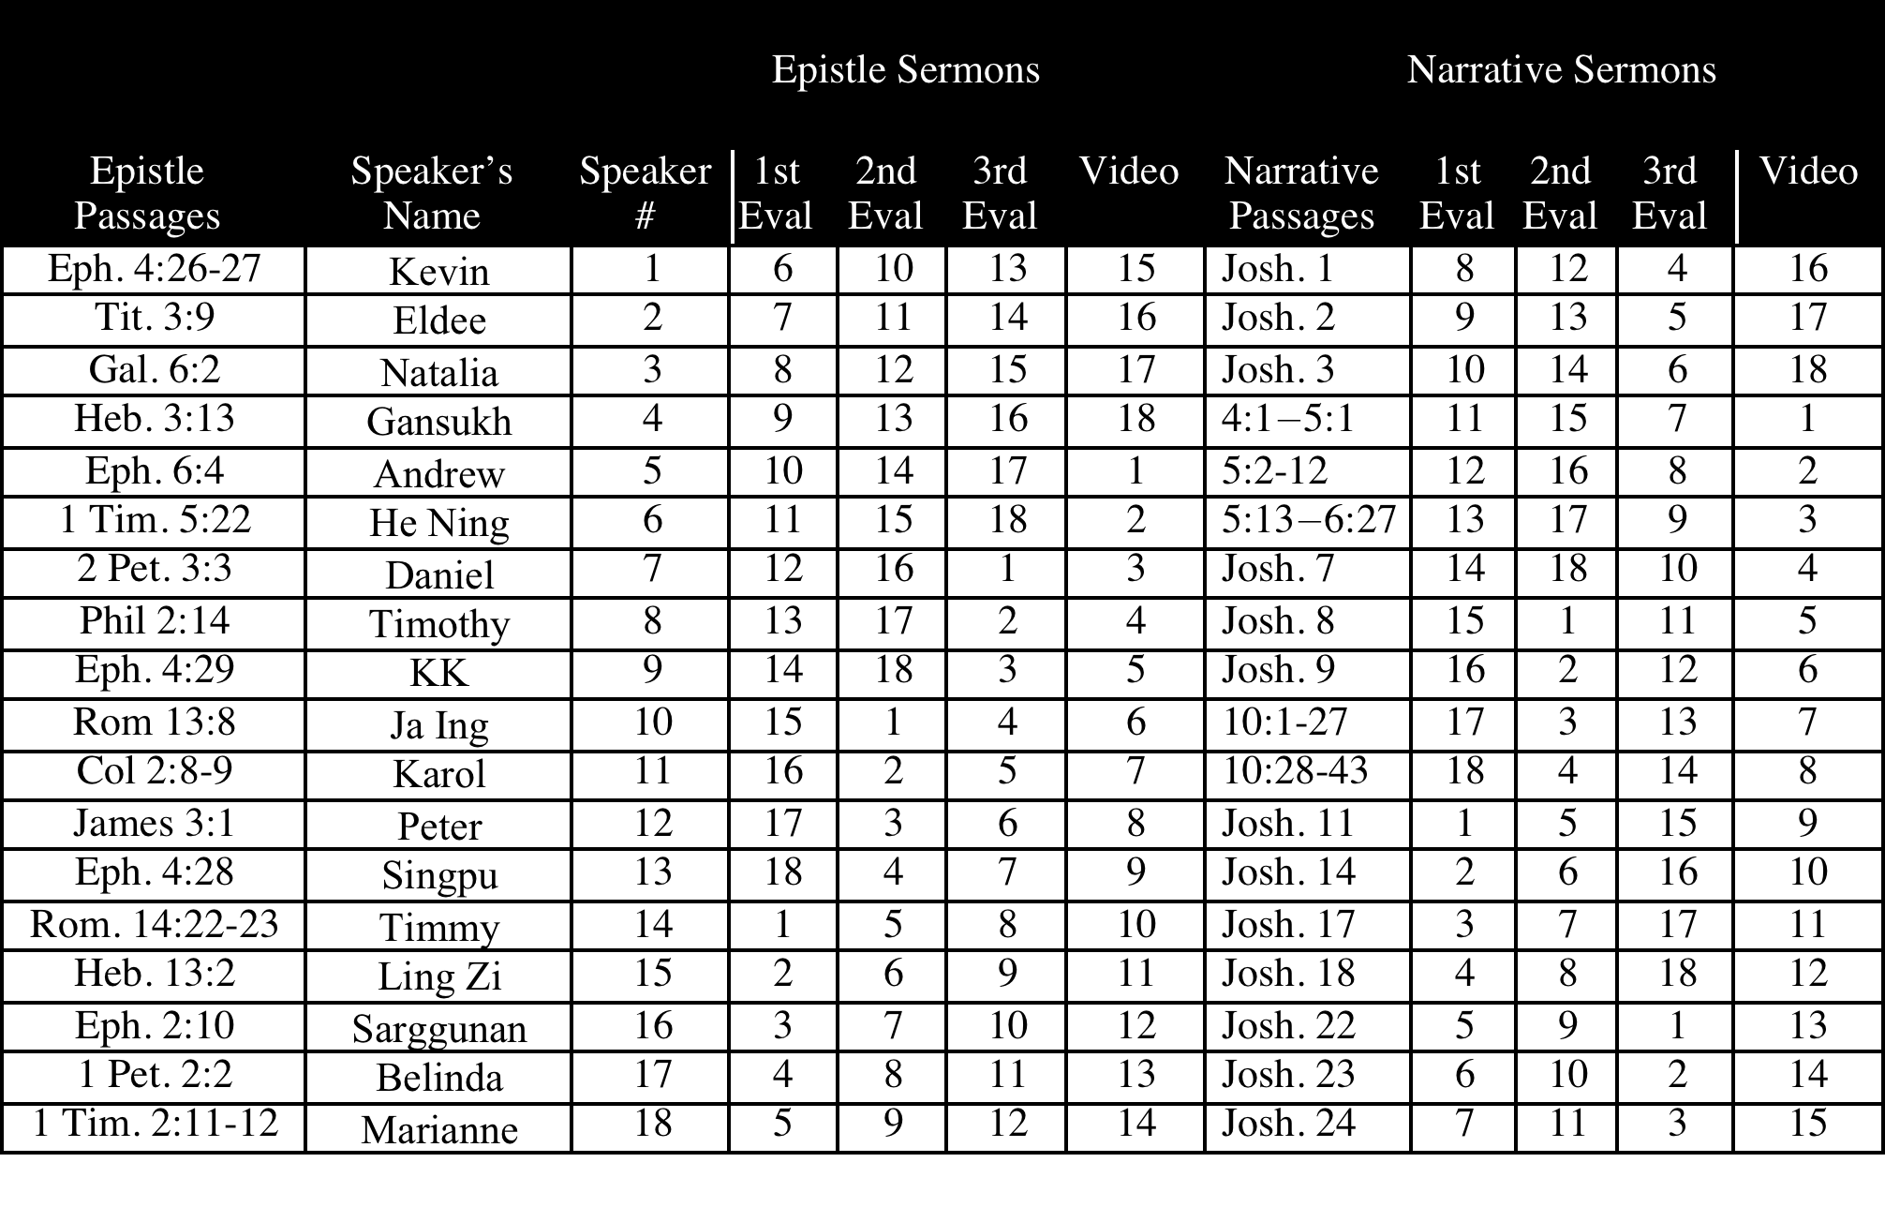
SBC Diekepuko mu Capiko 2012
viii
July-Nov 12

Slide 62
LBC Diekepuko mu Capiko
B

Slide 63
SBC Diekepuko mu Capiko
viii
July-Nov 05

Slide 64
SBC Diekepuko mu Capiko
viii
July-Nov 06

Slide 65
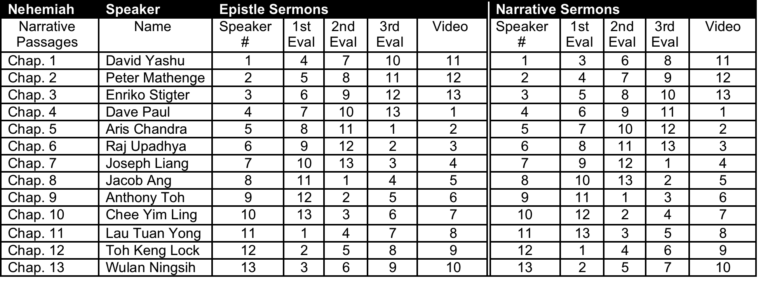
SBC Diekepuko mu Capiko
viii
July-Nov 08

Slide 66
HGST Diekepuko mu Capiko
B
Speaker |  | Epistle Sermons |  |  |  |  | Narrative Sermons
Speaker in Dr Rick's Group | Speaker in Dr Alan's Group | Spkr # | 1st Eval | 2nd Eval | 3rd Eval | Epistle Texts | Spkr # | 1st Eval | 2nd Eval | 3rd Eval | John Texts
 |  | 1 | 4 | 7 | 6 | Rom 13:8 | 1 | 5 | 8 | 7 | 1:19- 51
 |  | 2 | 5 | 8 | 7 | Gal. 6:2 | 2 | 6 | 9 | 8 | 2:1-11
 |  | 3 | 6 | 9 | 8 | Eph. 2:10 | 3 | 7 | 10 | 9 | 2:12- 25
 |  | 4 | 7 | 10 | 9 | Eph 4:26-27 | 4 | 8 | 1 | 10 | 3:22- 36
 |  | 5 | 8 | 1 | 10 | Eph. 4:28 | 5 | 9 | 2 | 1 | 4:1-42
 |  | 6 | 9 | 2 | 1 | Eph. 4:29 | 6 | 10 | 3 | 2 | 4:43- 54
 |  | 7 | 10 | 3 | 2 | Eph. 6:4 | 7 | 1 | 4 | 3 | 5:1-46
 |  | 8 | 1 | 4 | 3 | 1 Tim. 5:22 | 8 | 2 | 5 | 4 | 6:1-24
 |  | 9 | 2 | 5 | 4 | Tit. 3:9 | 9 | 3 | 6 | 5 | 6:25- 71
 |  | 10 | 3 | 6 | 5 | Heb. 3:13 | 10 | 4 | 7 | 6 | 7:1-52
May 2010

Slide 67
SCM Diekepuko mu Capiko
B
January 2011

Slide 68
HGST Mhatho Chiivoketuoko
v
Kephrii (10%)
Kethu mhatho (25%)
N kekhrohi (5%)
Diekepu (60%)

Slide 69
LBC Mhatho Chiivoketuoko
v
Kephrii (10%)
Kethu mhatho (25%)
N kekhrohi (5%)
Diekepu (60%)

Slide 70
SCM Mhatho Chiivoketuoko
A
Kephrii
(25%)
Kethu mhatho (25%)
Diekepu
(50%)

Slide 71
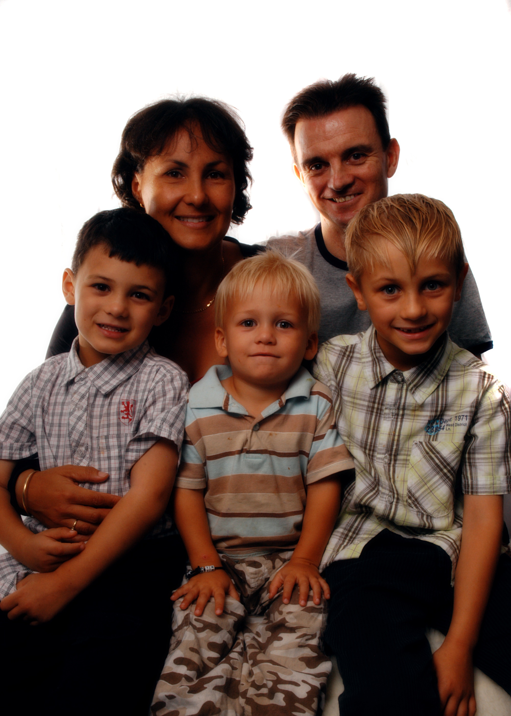
Stanley Kikru
Alan
Kathleen
Luke
Jackson
Caleb

Slide 72
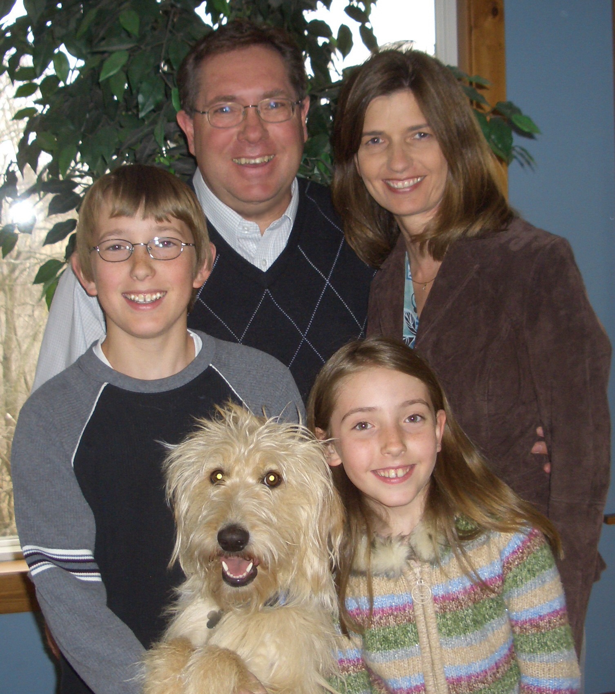
Sheveland Kikru
Ron
Jodi
Luke
Jessica
Holly

Slide 73
Thedze diepuko
v
Kikemhie di chiita…

Slide 74
Thedze diepuko nu semorokesuo
v
Puo die
Puo zho
Kirapuo nu separshikecii
Puorhi
Medzevoketuoko

Slide 75
Mehokeshii thedze yopuo
vi
KEKHRIE se di puo khrietho-u la siakeshii (Johan 15:13)
Vietnam kegikecii teiu nu, meriinuoko kikheki Kekramiako Marine Base puo ba. Khunhiepuo Viet Cong we kepounya kelhoushii di meriinuoko kekra dukhriwata mu miakekra riizapesuophi. Kai-ii kecii thepfunuomia yopuo puo zeu we riizha pesuo phi di bata di thezie se morosuo bata. Kai zeu we puo zie zhati krisekecii puo mu hau liro Kai zie ze kemhie. Kai we thezie se huonieho tsiilieyakezha simo derei Kekramia darukesiu we puo ki pu di sie hau we puo zeu rhilalie kevi kemeriiu riibeitaii di pushii, sitse Kai we puo zie khashii tuoii di puo die khashii.
Kai zie se puo zeu tsiikebaki Kai we pesikhoi di kra ba. Darukesiu we sie puo kemeziebatamonhie idi ketsokevo ki Kai we mozo di puta. Kenuoza Kai we kra za la shii. Derei puo we darukesiu ki kemeziebamoii di pulashii. ThelanuDarukesiu we sie, “Kidipuo chiitemu, Kai?” sitse Kai we kra di sie, “A kikeciikipuo sia tatuo ga, kepethau, a kikeciikipuo sia tatuo ga?” idi puta. Kai we puo zie houyo pie se puo zeu tsiiketuo simo di puo-e puo zie pete nhie idi le ba, mu puo-e puo zeu la puokelhou khashii tuoii di puo pepi baketala.
Dr. Rick Griffith, SBC Chapel, 4 May 2010

Slide 76
Zhakhra Zasikropuo
vii
kedziinu | Die kewe | Die kesa se pu meciisakuokecii
TC/TI/SD | Ukepenuopfii medo sikelie—MITU TU keciikemhie | UKEPENUOPFII MEDO known after decision made
TI/SD | MEHOKESHII—kite pepruokecii | MHAKERE ze kesekecii Khristamia la vi
TI/SP | Satan U VIIPIE u bu kaketa | Mhachii khrieliekemo we u keviko penyiiwalievi

Slide 77


Diekepuzho • BibleStudyDownloads.org
Get this presentation for free!
Notes:
Preaching (pr)
Homiletics

Slide 78
Black

